Slide 1
Welcome!!! Back to School Night 2022 Mrs. Jenna Snell
In class support and supplemental services

Slide 2
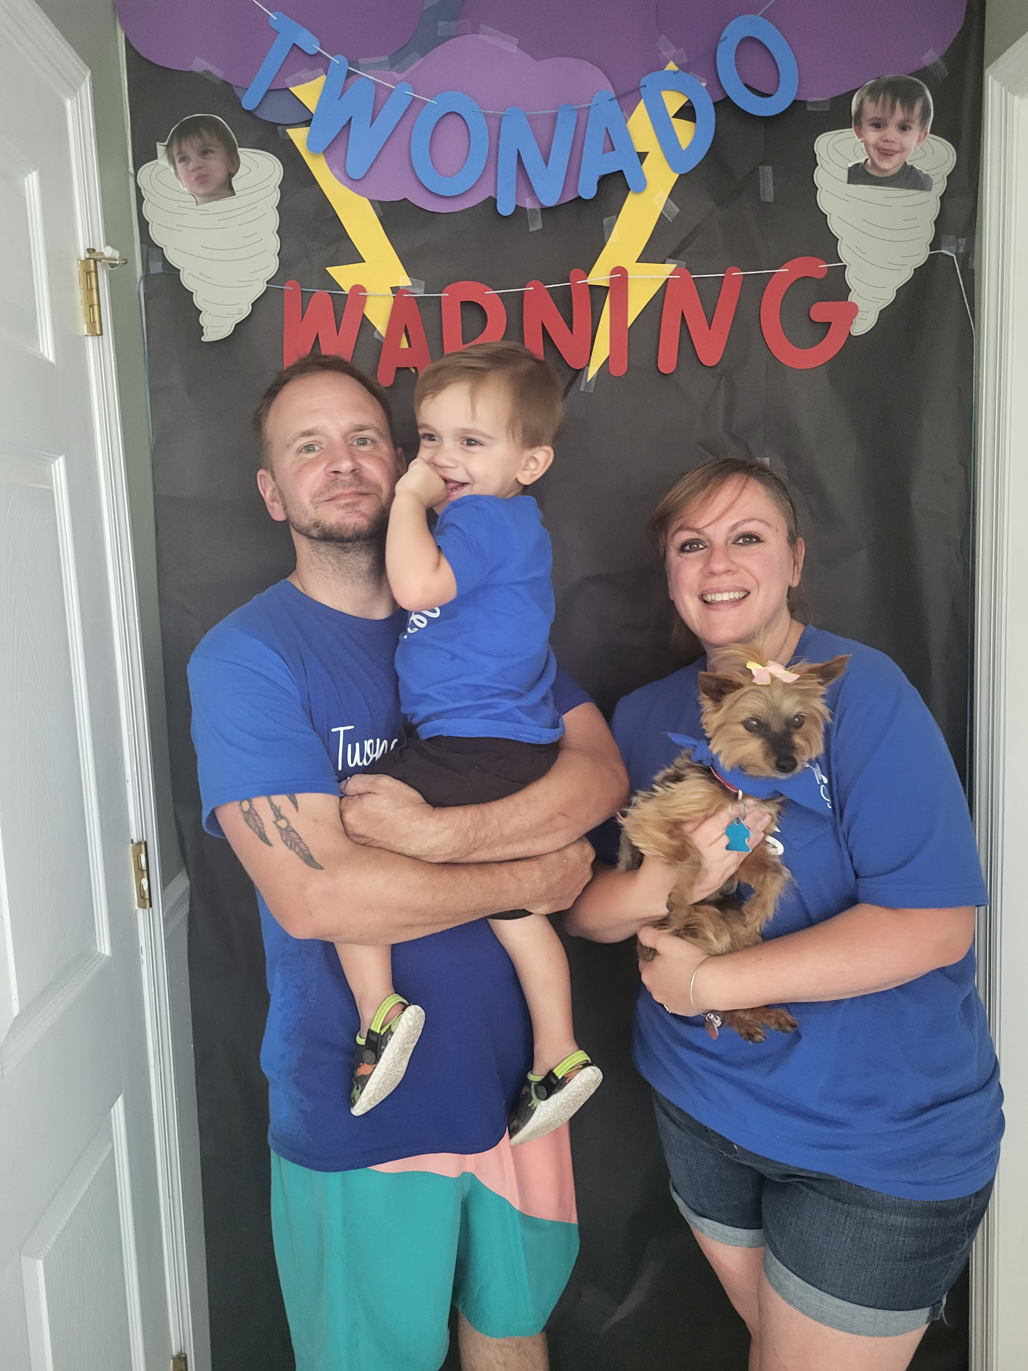
Meet Mrs. Snell
*Proud teacher in Barnegat since 2012
*Born, raised, and still live in Barnegat with my husband, Ryan, of almost 8 years, our 2 year old son, Colby, and dog Roxi
*5th year as a member of the Horbelt family
*Before coming to RLHS, I taught 3-5 MD, 3rd grade Inclusion and Basic Skills. Also completed maternity leaves in 3rd and 7th grade
*Bachelor’s and Master’s Degree from Georgian Court University
*I *love* teaching, and knew this is what I wanted to do from the time I was a little girl.
*Your children are “my” children

Slide 3
**Please contact me any time**
*Class DoJo message
*Email: jsnell@barnegatschools.com
*Telephone: 609-660-7500 mailbox #18263
*I will return all communication as soon as possible, but definitely within 24 hours
*If I don’t have an answer for you, I will get one for you!

Slide 4
Mrs. Snell’s Schedule
Period 1 ~ ELA with Mrs. Mallia Period 2 ~ ELA with Mrs. Mallia
Period 3 ~ Supplemental - 6th grade SPIRE Period 4 ~ Prep Period 5A ~ Recess Duty Period 5B ~ Teacher Lunch Period 6 ~ Math with Mrs. DeMeola
Period 7 ~ Math with Mrs. DeMeola
Period 8 ~ Math with Mrs. Buscio
Period 9 ~ Math with Mrs. Busico

Slide 5
In Class Support ELA & Math
*Provide support for your children with Special Needs
*Monitor and track IEP goals
*Provide small group instruction
*Provide accommodations and modifications as per your child’s IEP
*Reteach and remediate skills when necessary
*Provide opportunities for enrichment
*Be your child’s cheerleader, and encourage them throughout the year

Slide 6
Supplemental Services
*Math, Reading Comprehension or Decoding
*Decoding is completed using SPIRE. Students are placed in the appropriate level depending on where he or she placed in the Placement Test
*Reading comprehension and math are based on student need and/or IEP goals
*Small group or 1:1
*Contact me any time to discuss your child’s progress

Slide 7
Grading & Progress Monitoring
*Refer to the general education teacher for specific information regarding grading
*IEP goals are tracked through classroom and individual work. All work is returned to students, and I will keep a copy for monitoring purposes
*You may see a number 1-5 on your child's classwork. Below is what each number means. You also see this on the quarterly report card.
5- Exceeding Expectations
4- Meeting Expectations
3- Approaching Expectations
2- Partially Meeting Expectations
1- Not Meeting Expectations

Slide 8
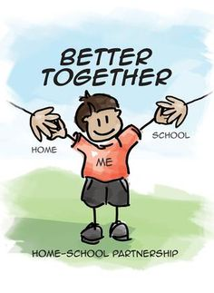
Thank you!
*Please reach out to me if you have any questions or concerns.
*I look forward to working with your children this year

